Slide 1


We invite you to join our team.
Be part of a collective impact.
Help improve millions of lives as a board member of our Foundation.

Slide 2

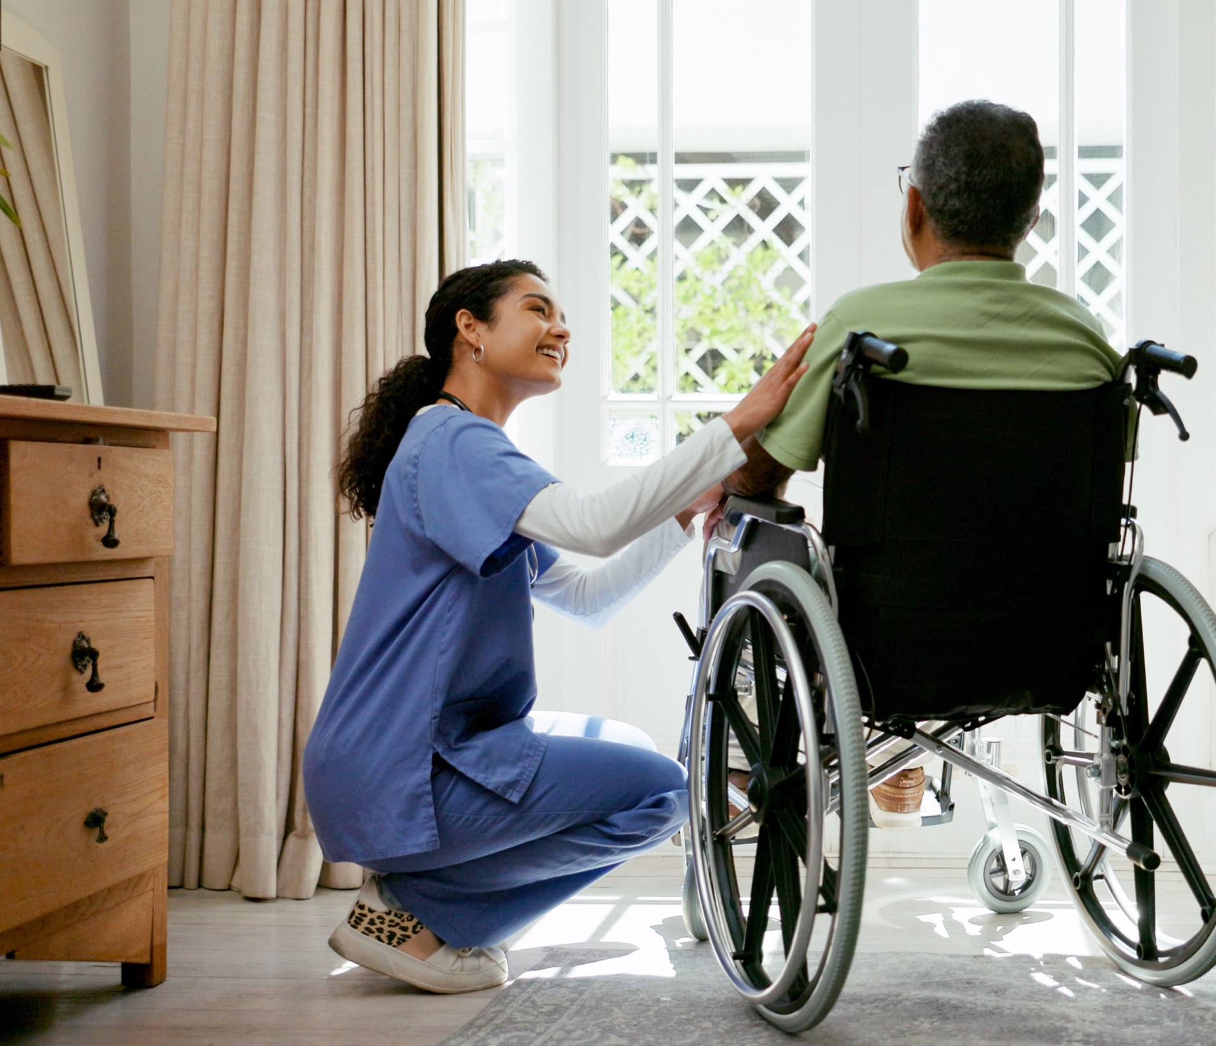
Through serving, you will
Witness the joy of generous donors
See lives saved and transformed
Invest in services that impact people, families and communities across five states
Serve with passionate, committed board members and staff

Slide 3

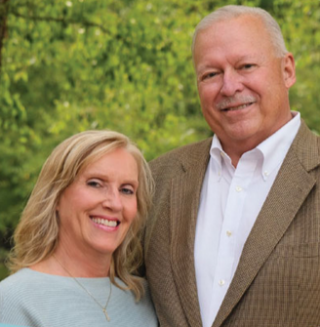



Generous donors
They saved my life with unexpected open-heart surgery. We can make our community where we live and raised our family a better place by supporting the hospital and health care services for everyone.
Angie & Barry Clark
Lima, OH
Fundraising in 2024
• $134 million given by 15,067 donors
• $5.97 return on investment for each dollar spent on fundraising operations
• Six-year Association for Healthcare Philanthropy High Performer

Slide 4
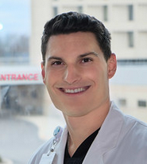
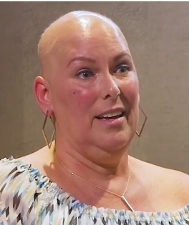
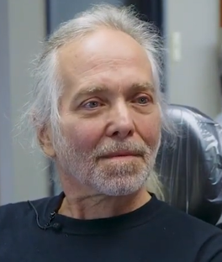
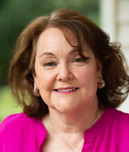
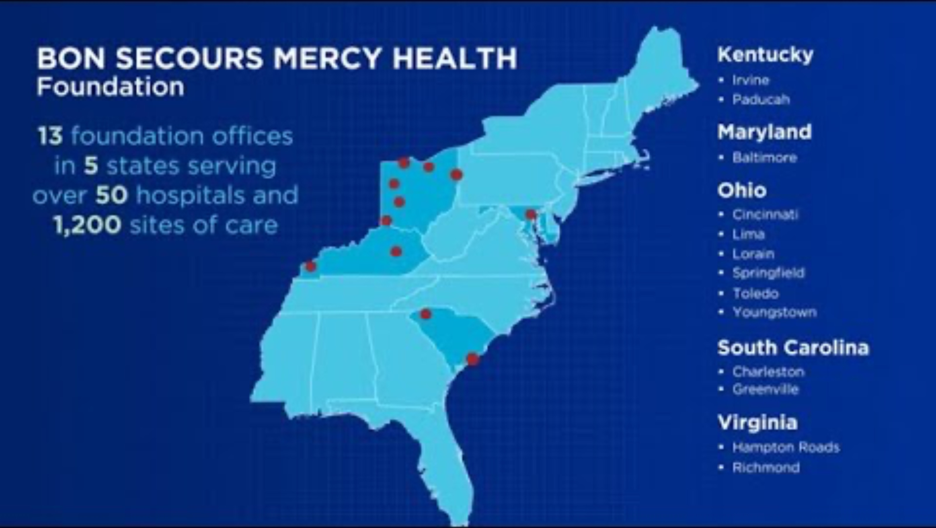
Saving and transforming countless lives
Our donors make a difference that improves and saves lives. Every donation helps:
provide medical services
support outreach programs
make each community a better, healthier place to call home
In this video, hear directly from people who share why they are grateful for Bon Secours Mercy Health (BSMH) Foundation donors.

Slide 5
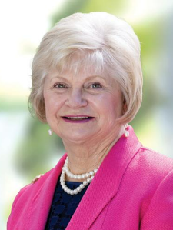
Committed board members
• 246 Foundation board members
• 100% charitable giving in 2025
Gifts totaling $6 million influenced by board members
I give and serve on the board because I am overwhelmed by all that our associates do to make medical care accessible and as comfortable as
possible for our communities, especially for those who struggle financially.
I am humbled by the generous support of so many donors. I am a ‘loud
and proud’ Bon Secours Mercy Health cheerleader.
Linda Rigsby, JD
Chair, BSMH Foundation
Richmond, VA
5

Slide 6
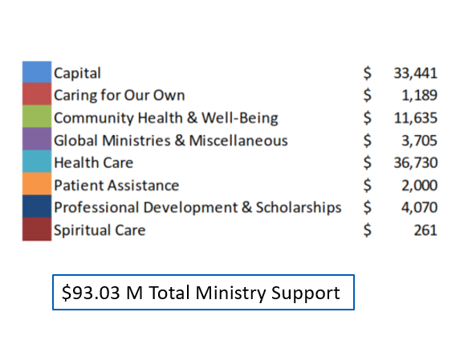
Maximizing the impact of giving
2025 Philanthropic support for BSMH’s Ministry: $93 million

Slide 7
Maximizing the impact of giving
Mission Outreach Program
$7.2 million awarded since 2020
Focus of funding:
Address social determinants of health
Improve health outcomes
Create healthy community partnerships
Recent impacts
Eviction prevention and financial education
Violence response training for fire and EMS
Medication assistance for chronic disease patients in need
Independence for seniors through home safety and balance training
Feminine hygiene kits for students

Slide 8
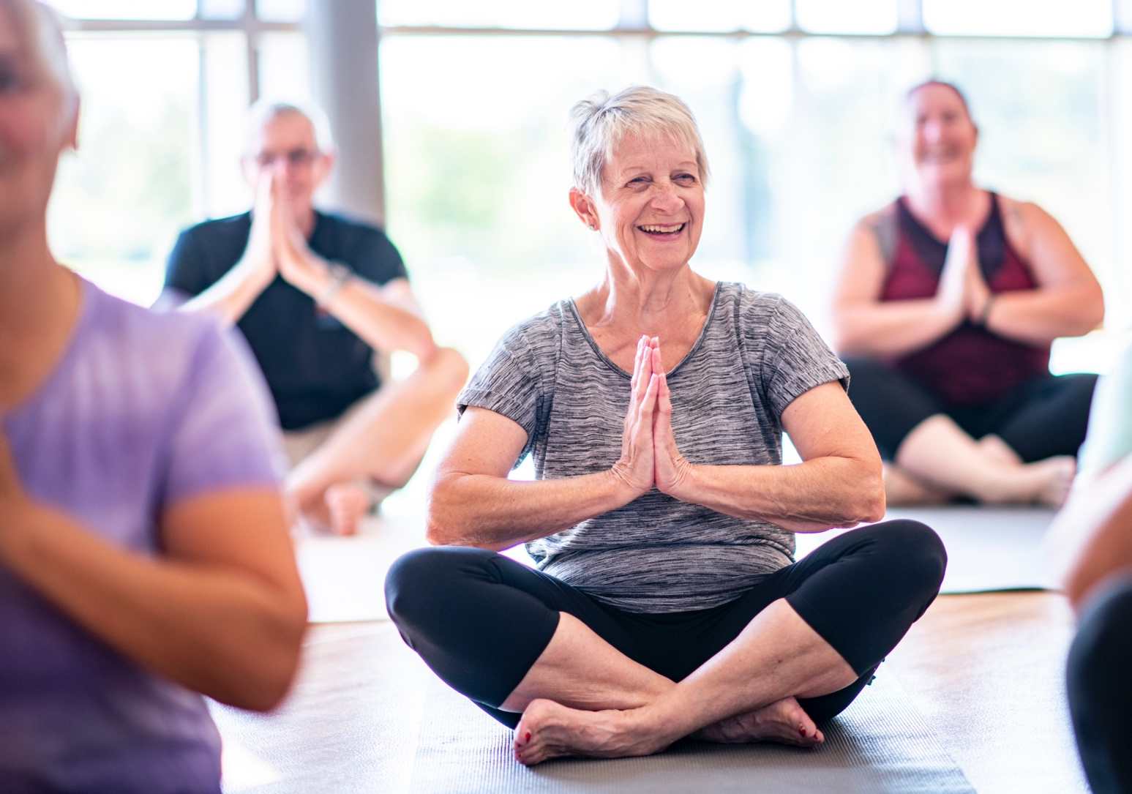

Maximizing the impact of giving
Mercy Health – Marcum and Wallace Hospital takes a holistic approach to wellness. Their programs have a lasting impact on people’s health
and wellbeing.
Jessica, Program participant
Irvine, KY

Slide 9
Maximizing the impact of giving
Foundation Awarded Matches
The Board allocates an annual budget to provide matching funds for selected market Foundations’ capital fundraising efforts.
2023 - $375,000 awarded
Mobile mammography unit – Greenville
New hospital – Hampton Roads
Hospital renovations – Richmond
2025 - $500,000 awarded
Graduate Medical Education Facility – Cincinnati
Rehab Fitness Center – Greenville
Associate Child Care – Lima
Critical Care Transport – Richmond
2024 - $500,000 awarded
Hospital lobby renovation – Greenville
Mobile mammography unit – Lorain
Medical center for violence
response team – Richmond
Cancer care center – Springfield
2026 - $600,000 awarded
Mobile mammography unit – Hampton Roads
Graduate Medical Education – Lorain
Critical care patient tower – Richmond

Slide 10
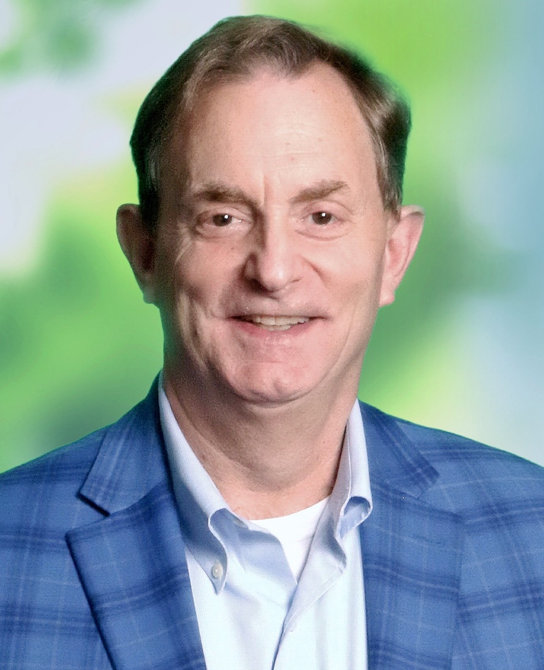

Maximizing the impact of giving
Lives will be saved through the Foundation Awarded Match. It created energy among our board and community, giving a needed boost to our campaign for mobile mammography.
Erik Whaley, President
Bon Secours St. Francis Foundation, Greenville, SC

Slide 11
Maximizing the impact of giving
Health Impact Fund
Allocates approximately $1 million annually for clinical and non-clinical efforts to increase the ministry’s capacity to address social determinants of health.
2026 awards in Baltimore, Cincinnati, Greenville, Irvine, Paducah, Springfield, Toledo and Spiritual Health
Baltimore – Urban Farm and Healthcare Career Training
Paducah – Patient Transportation Service
Spiritual Health – Volunteer Chaplain Training
Toledo – Forensic Nursing and Infant Mortality

Slide 12

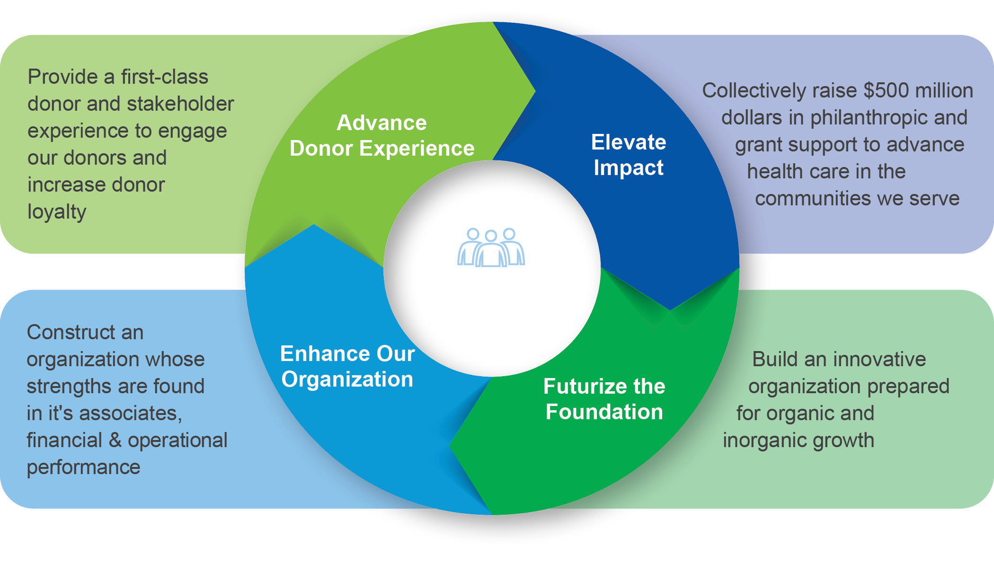
The future: Our aspirational goals
2024-2028 Strategic Plan

Slide 13
The future: Our aspirational goals
Raise $500 million by 2028
• $10 million increase in annual fundraising (from $90 - $100 million)
Increase $500,000+ transformational gifts
• Current average: 24 per year
  • 19 gifts from organizations
  • 5 gifts from individuals

Slide 14
The future: Our aspirational goals
Increase fundraising for ministry-wide priority initiatives
• Equitable access to care
• Healthcare improvements and advancements
• Associate wellbeing
• Expanded community health services
100% of board members actively build and strengthen relationships with donors and prospective donors
Be the BEST – a national leader in healthcare philanthropy

Slide 15
The future: Our aspirational goals
By increasing fundraising revenue, BSMH can:
Open free/low-cost mobile and school clinics in neighborhoods that lack health care
Innovate nursing with virtual and hybrid roles and tech-enablement (equipment finders, rover charting, medication administration)
Provide healthy food and transportation assistance to address people’s social determinants of health
Help people in need access health care to prevent sepsis, treat high blood pressure and have a healthy pregnancy and delivery
Increase forensic nursing for victims of sexual assault and domestic violence

Slide 16
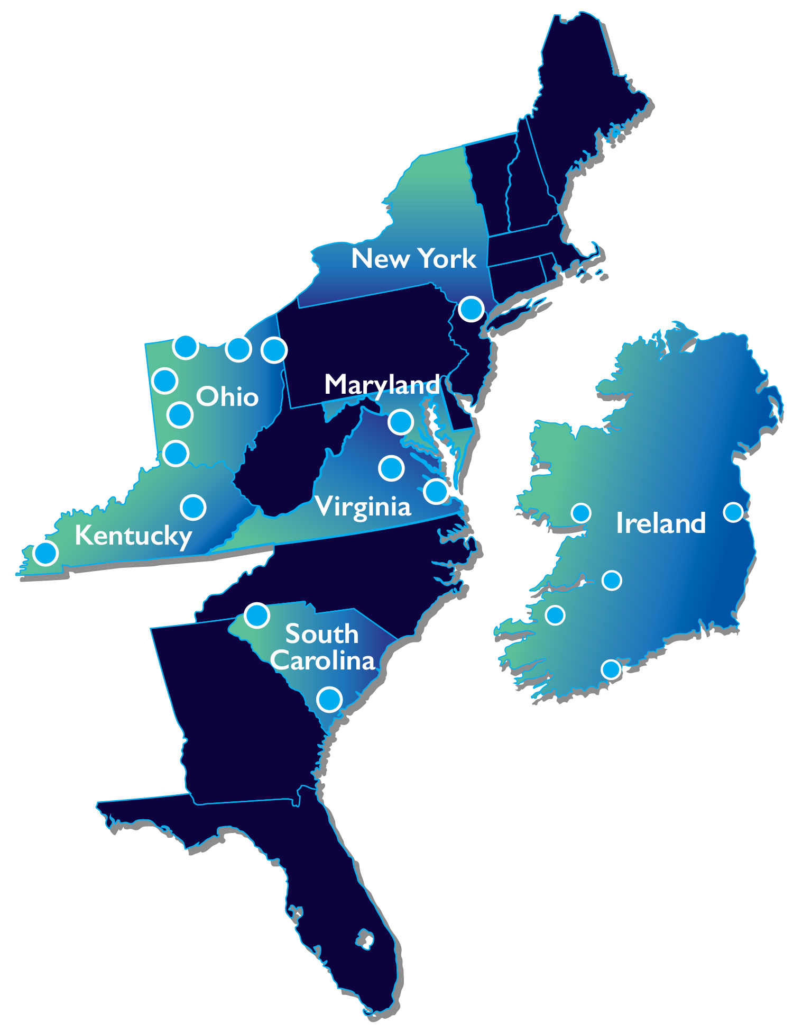







Who we are
FIFTH LARGEST U.S. Catholic health care system;
the LARGEST not-for-profit private provider in Ireland
MORE THAN 1,200 SITES OF CARE IN THE US
AND IRELAND
Approximately $13 BILLION
in proforma net operating revenue
MORE THAN $600 MILLION IN ANNUAL
COMMUNITY BENEFITS ACROSS 5 STATES
49
HOSPITALS
3,000* PROVIDERS IN THE US
450 CONSULTANTS IN IRELAND
60,000 TOTAL ASSOCIATES
*BSMH Medical Group physicians and APCs
updated 01/24

Slide 17


Who we are
Baltimore, MD
Paducah, KY
Cincinnati, OH
Richmond, VA
BSMH Foundation
Board of Directors
Ministry-wide / multi-market
fundraising and initiatives
Develop and approve policies
Funding distributions from
system Foundation
Oversee $436 million in Foundation assets
Market Foundation Boards
Local fundraising, initiatives and
funding distributions
Greenville, SC
Springfield, OH
Hampton Roads, VA
Toledo, OH
Irvine, KY
Youngstown, OH
Lima, OH
Charleston, SC
(joint venture)
Lorain, OH

Slide 18
Being a successful board member: Expectations
Connect • Inform • Lead • Build
Commit to growing charitable giving to the Foundation
Make BSMH one of your top charitable priorities, leading by example with your annual giving and support for special campaigns/projects
Influence your significant network of peers that can give generously
Match donors’ passions with the needs of BSMH’s patients and communities
Passionately promote the Mission of BSMH and the Foundation

Slide 19
Being a successful board member: Expectations
Roles of a system Foundation board member
Raise funds for strategic priorities at market and system levels
Approve fundraising vision, expectations, and goals for the system and market-level Foundations
Provide legal, fiduciary, best-practice fundraising and board recruitment oversight
Ensure accountability of market Foundations by monitoring results and progress toward goals
Coordinate market Foundation board members and staff in sharing best practices between Foundations to elevate results
Approve operational resources to support all levels of the Foundation

Slide 20
Being a successful board member: Expectations
Time commitment
Board orientation in Q1 (one hour via Zoom)
Quarterly board meetings (1-2 in person)
Serve on one board committee, with quarterly Zoom meetings
Optional quarterly philanthropy training sessions (Zoom)
Serve a term of three years, renewable for three total terms

Slide 21
Being a successful board member: Expectations
Foundation board committees
Stewardship
Monitor budget and financial results to maximize resources
Recommend funding allocations for programs and capital investments that improve our communities
Philanthropy
Prioritize fundraising needs and articulate a compelling case for philanthropic support
Increase fundraising revenue for ministry-wide needs and multi-market initiatives
Board Engagement & Nominations
Identify and nominate highly qualified board members
Implement strategies to increase board engagement in fundraising

Slide 22
Serve with the best
2026 BSMH Foundation Board of Directors
Chair
Linda Rigsby, JD
Richmond, VA
Vice Chair
Karen M. Johnson, JD
Los Angeles, CA
Secretary
Lynn Hammerstrom
Temperance, MI
Treasurer
Jeannine Stephenson-Buffong, MPH, DMD
Teaneck, NJ
Immediate Past Chair
John H. Harris, III MEd
Petoskey, MI
Chair, Board Engagement &
Nominations Committee
John H. Harris, III MEd
Petoskey, MI
Chair, Philanthropy Committee
Karen M. Johnson, JD
Los Angeles, CA
Chair, Stewardship Committee
Jeannine Stephenson-Buffong, MPH, DMD
Teaneck, NJ
Cynthia Andrews, MBA
Oberlin, OH
Germaine Bennett, EdD
Youngstown, OH
Mary Davidson, MSN
Cincinnati, OH
Fred Gilmer
Greenville, SC
Sister Pat Eck
Marriottsville, MD
Jamie Horn
Cincinnati, OH
Elizabeth Lang
Los Angeles, CA
John W. Sharp, MS
Cleveland Heights, OH
Ex Officio
Chief Legal Officer &
Executive Leadership Sponsor
Michael Bezney, JD
Bon Secours Mercy Health
Pagosa Springs, CO
Ex Officio
President
Timothy Koder
Bon Secours Mercy Health Foundation
Toledo, OH

Slide 23




Contact us
President
Tim Koder
tjkoder@mercy.com
(419) 277-0881
Chair
Linda Rigsby
mlrigsby163@comcast.net
(804) 398-8566
Board Relations System Director
Becky Sittason
bsittason@mercy.com
(859) 760-7017
Follow the Foundation
GiveBSMH.org
YouTube.com/@BonSecoursMercyHealthFound
https://www.facebook.com/MercyHealthFoundation
Facebook.com/BonSecoursFoundation
17858BSMFOU (4-24)

