Slide 1
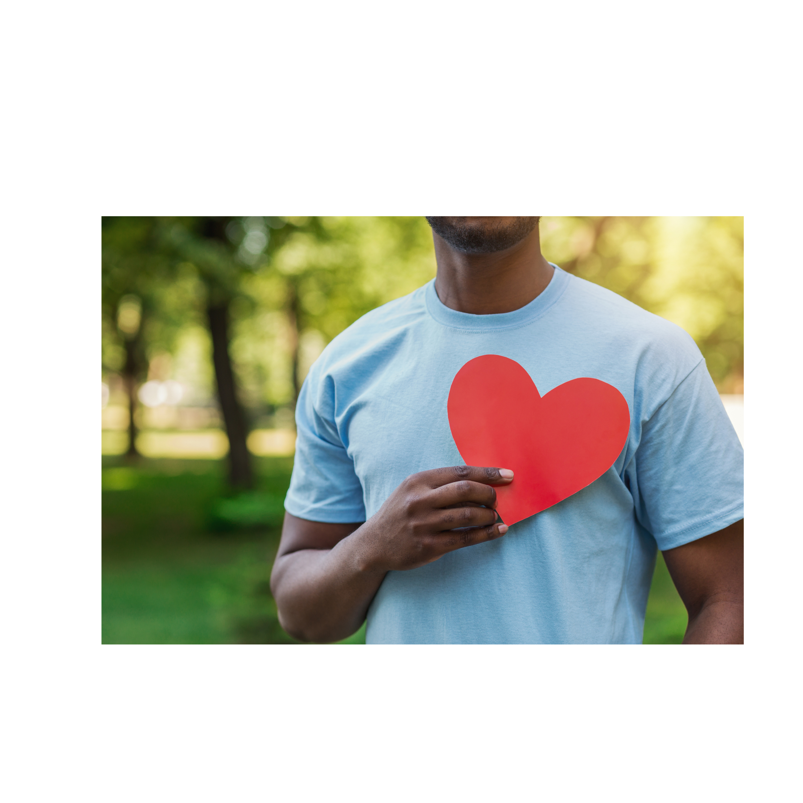


Mercy Health Foundation Irvine
​
Notes:
These presentation notes have been designed to be read verbatim by the leader
Today we will be reviewing the upcoming Bon Secours Mercy Health Associate Campaign!

Slide 2
WHAT IS GIVE FOR GOOD?
OUR ANNUAL ASSOCIATE GIVING CAMPAIGN
The Campaign is an opportunity for Associates to support the mission of Bon Secours Mercy Health through a variety of gift options that benefit our patients, associates, and the local communities we serve.
Notes:
What is the Give for Good Associate Giving Campaign?
The Campaign is an opportunity for our associates to support our mission through a variety of gift options. Gifts can be directed to your community and to several programs and special projects.
This year’s campaign kicks off on August 27th with our day of giving celebration, THE BIG GIVE.
The Campaign will continue through the entire month of September. Associates will be receiving campaign information at their home, by email, and through the Weekly Pulse.

Slide 3

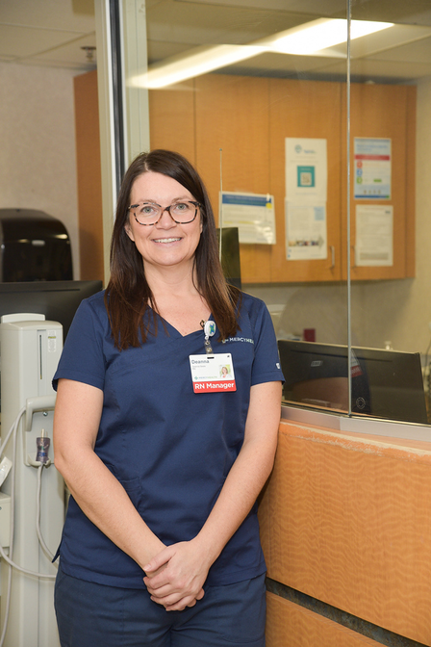
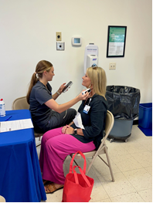
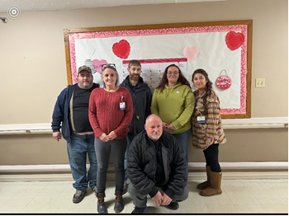

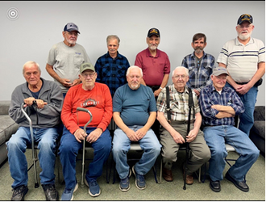
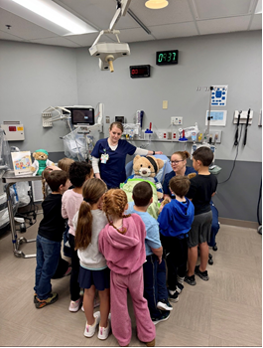
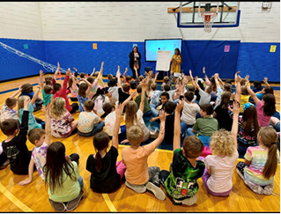
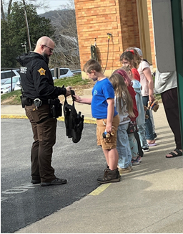
Your Giving in Action
Health Fair Screening Carotid/
Thyroid Scan
I see the difference this hospital makes in the lives of the people in the communities
that we serve.
-Deanna Seale
Nursing Manager | Irvine
Way Back Program
Veterans
Program
Teddy Bear Fair
Red Ribbon Week Elementary Schools/
Substance Use
Teddy Bear Fair
Notes:
For nearly two decades, Deanna Seale has served patients and families at Marcum and Wallace Hospital with compassion and commitment.
Her dedication doesn’t stop at the bedside. Deanna is also a proud supporter of the Foundation.
“I see the difference this hospital makes in the lives of the people in the communities we serve.”
From Health Fair screenings to initiatives supporting veterans, helping individuals in recovery through the Way Back Program, and introducing elementary students to healthcare through the Teddy Bear Fair and Red Ribbon Week—every gift helps strengthen care, expand services, and bring compassion to those who need it most.

Slide 4
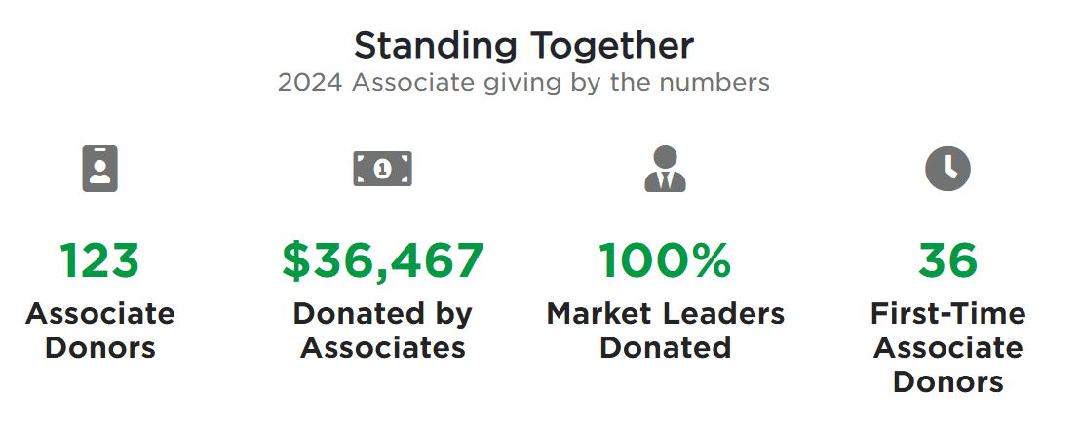
OUR IMPACT TOGETHER
Notes:
Here’s a look at the impact of our 2024 giving:
123 associates participated
36 were first-time donors
100% of the market leaders donated
Together we raised an incredible $36,467

Slide 5

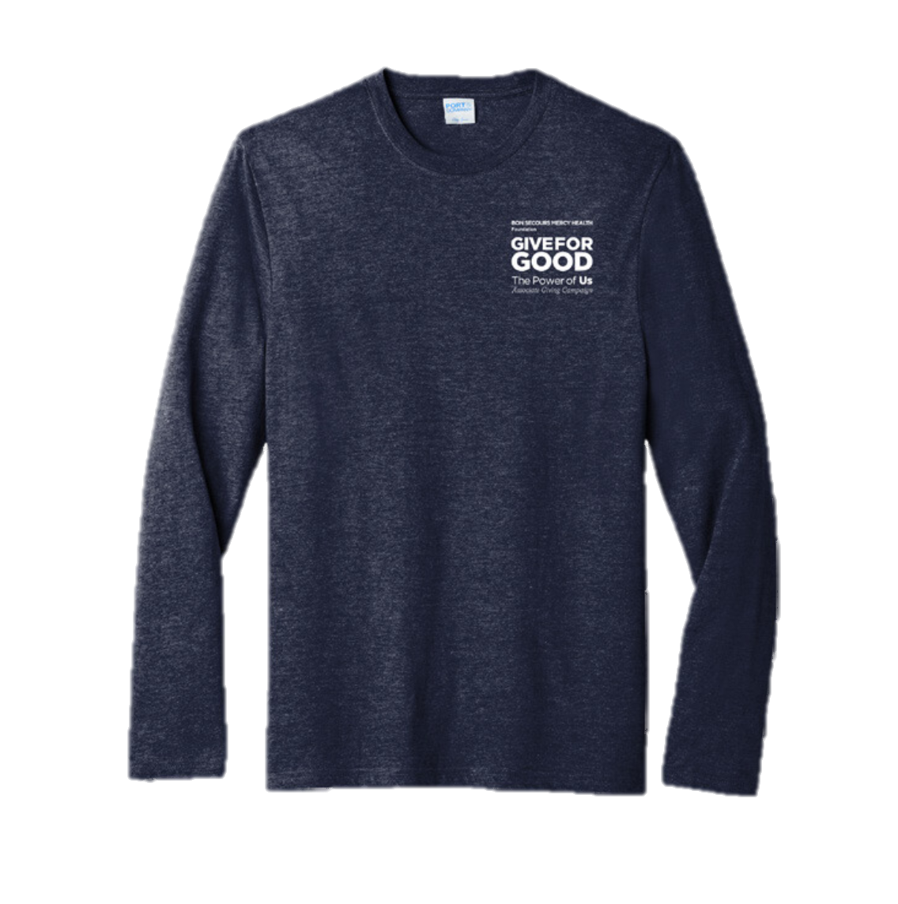
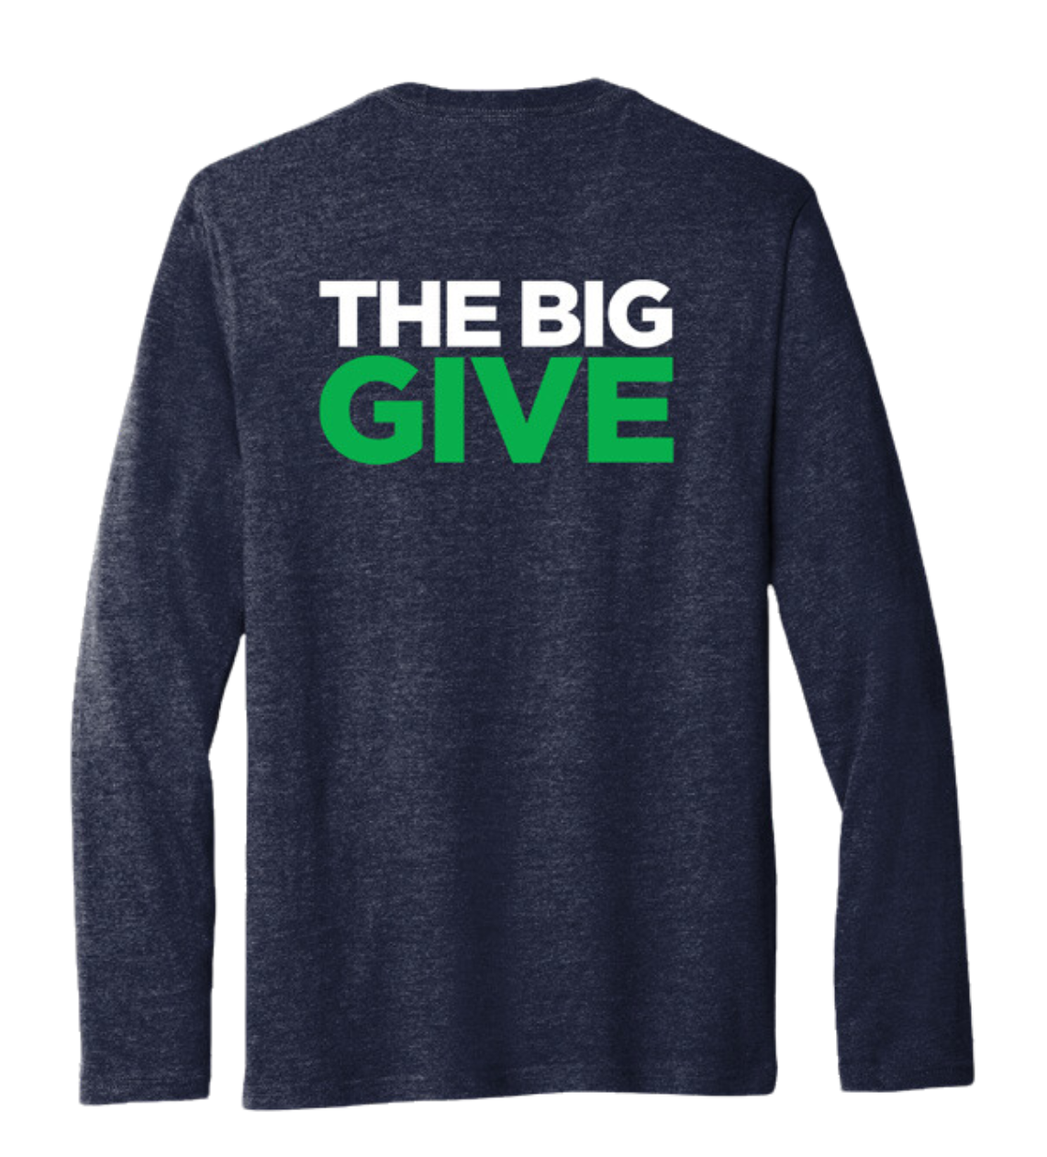
WHAT is THE BIG GIVE?
The 24-hour fundraising event to kick-off the Give for Good Campaign.
HOW can I celebrate THE BIG GIVE?
Watch for emails for more details!
WHY should I participate?
Every contribution adds up and can make a difference for those we serve.
WHEN do I make a gift?
Submit your gift NOW until 8/27/2025 to be counted in THE BIG GIVE efforts.
Current recurring gift donors will be counted and eligible for incentives.
Notes:
This year, THE BIG GIVE will take place on August 27th and will launch this year’s campaign.
This is a call to action for associates to make their gift in the first 24 hours of the Give for Good campaign and engage in activities in celebration of the kick-off of Give for Good.
Donors with recurring gifts are automatically eligible for THE BIG GIVE incentives, including The Big Give shirt for those at the Power Hour, Lead for Good, or Half Hour Hero levels!
Make sure to make your gift before midnight on 8/27!

Slide 6
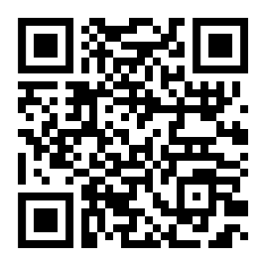
WAYS TO MAKE GOOD HAPPEN
Per Pay Period Deductions
  Power Hour
  Lead for Good
  Half Hour Hero
  Other chosen amount
One-time gifts: cash, credit card, payroll deduction
PTO
  Hourly associates
Visit bsmhgiveforgood.com or scan the QR Code to make your gift today!
Notes:
There are many different ways an associate can choose to make a gift.
Per pay period deductions that will take place the first pay period of 2026. Associates can choose to do a per pay period deduction at the Power Hour level, one hour of pay per pay period, Lead for Good, a $1,001 pledge for the year that can be deducted evenly throughout the year or in one deduction, Half Hour Hero, a gift of a half hour of pay per pay period, or at any amount they would like.
There is also an opportunity for associates to do a one-time payroll deduction that will take place in November. One-time gifts made by cash and credit card are also accepted.
Hourly associates are able to donate unused PTO (only hourly due to HR policy, if asked.)
Gifts can be made by simply filling out a form online at bsmhgiveforgood.com or returning the brochure received at each associate's home.

Slide 7

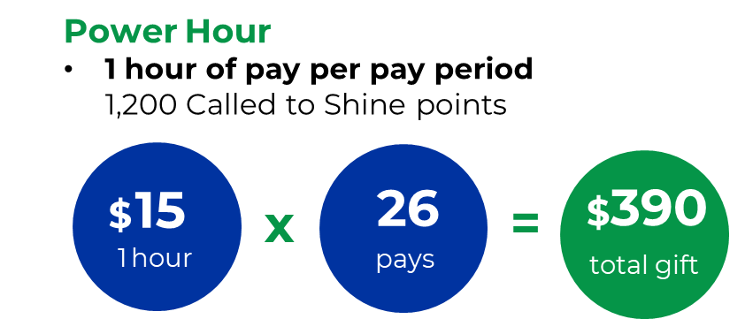
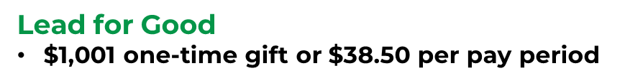


INCENTIVES
All other recurring donors
100 Called to Shine Points
The BIG GIVE donors
Donors who make a first-time, recurring gift before midnight 8/27/25 will receive 500 Called to Shine Points
1,000 Called to Shine points
All donors will receive 75 Be Well points.
600 Called to Shine points
Notes:
If associates give at the Power Hour, Lead for Good, or Half Hour Hero level, they can be eligible for the following rewards:
POWER HOUR 1 hour of pay per pay period
1,200 Called to Shine points
LEAD FOR GOOD $1,001 gift either one time or spread over 26 pay periods
1,000 Called to Shine points
HALF HOUR HERO ½ hour of pay per pay period
600 Called to Shine points
As a bonus, if a gift at these levels is made before midnight August 27th during THE BIG GIVE, donors can be eligible for a free shirt.
In addition to the giving level incentives:
Donors who make a first-time, recurring gift before midnight 8/27/25 will receive 500 Called to Shine Points
All other recurring gifts will receive 100 Called to Shine Points
ALL DONORS will receive 75 be well points

Slide 8
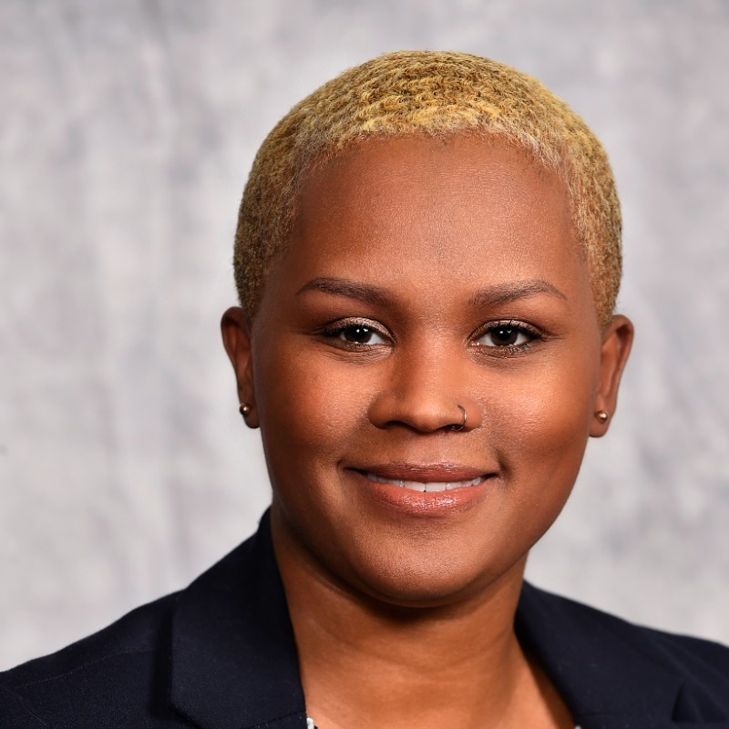
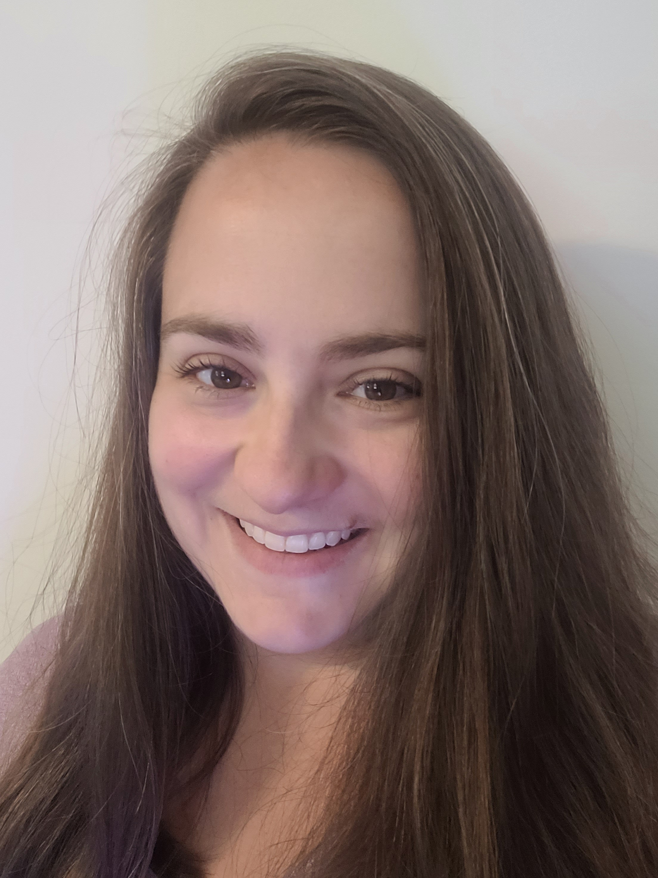
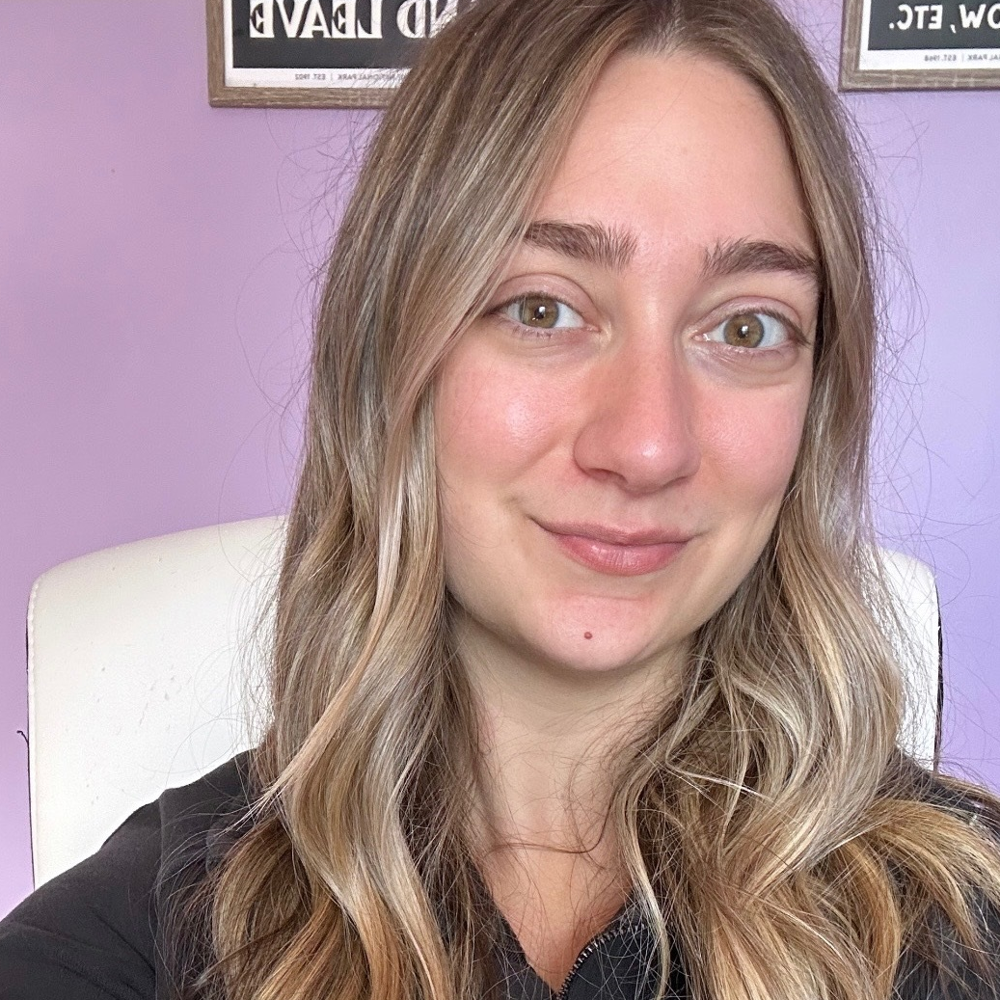
KEY CONTACT INFORMATION
Margo Lattanzio
BSMH Foundation Event Coordinator
Mlattanzio@mercy.com
724-961-6375
Elisheba Hawkins
Employee Giving Specialist
ehawkins@mercy.com
(513) 410-6272
Clare Gordon
Senior Employee Giving Specialist
csgordon@mercy.com
(513) 638-6811

Slide 9


Together we can make an impact right where we live & work!
BSMHgiveforgood.com
Notes:
Thousands of Bon Secours Mercy Health Associates support the Foundation's giving campaign each year. Many programs and services that help our patients and associates depend on your donations.
You will receive a letter and brochure with giving options for our market at home in August. Please read through the brochure and consider a gift to programs that mean the most to you.
The fastest and easiest way to give is online at BSMHgiveforgood.com.
Thank you!

