Slide 1
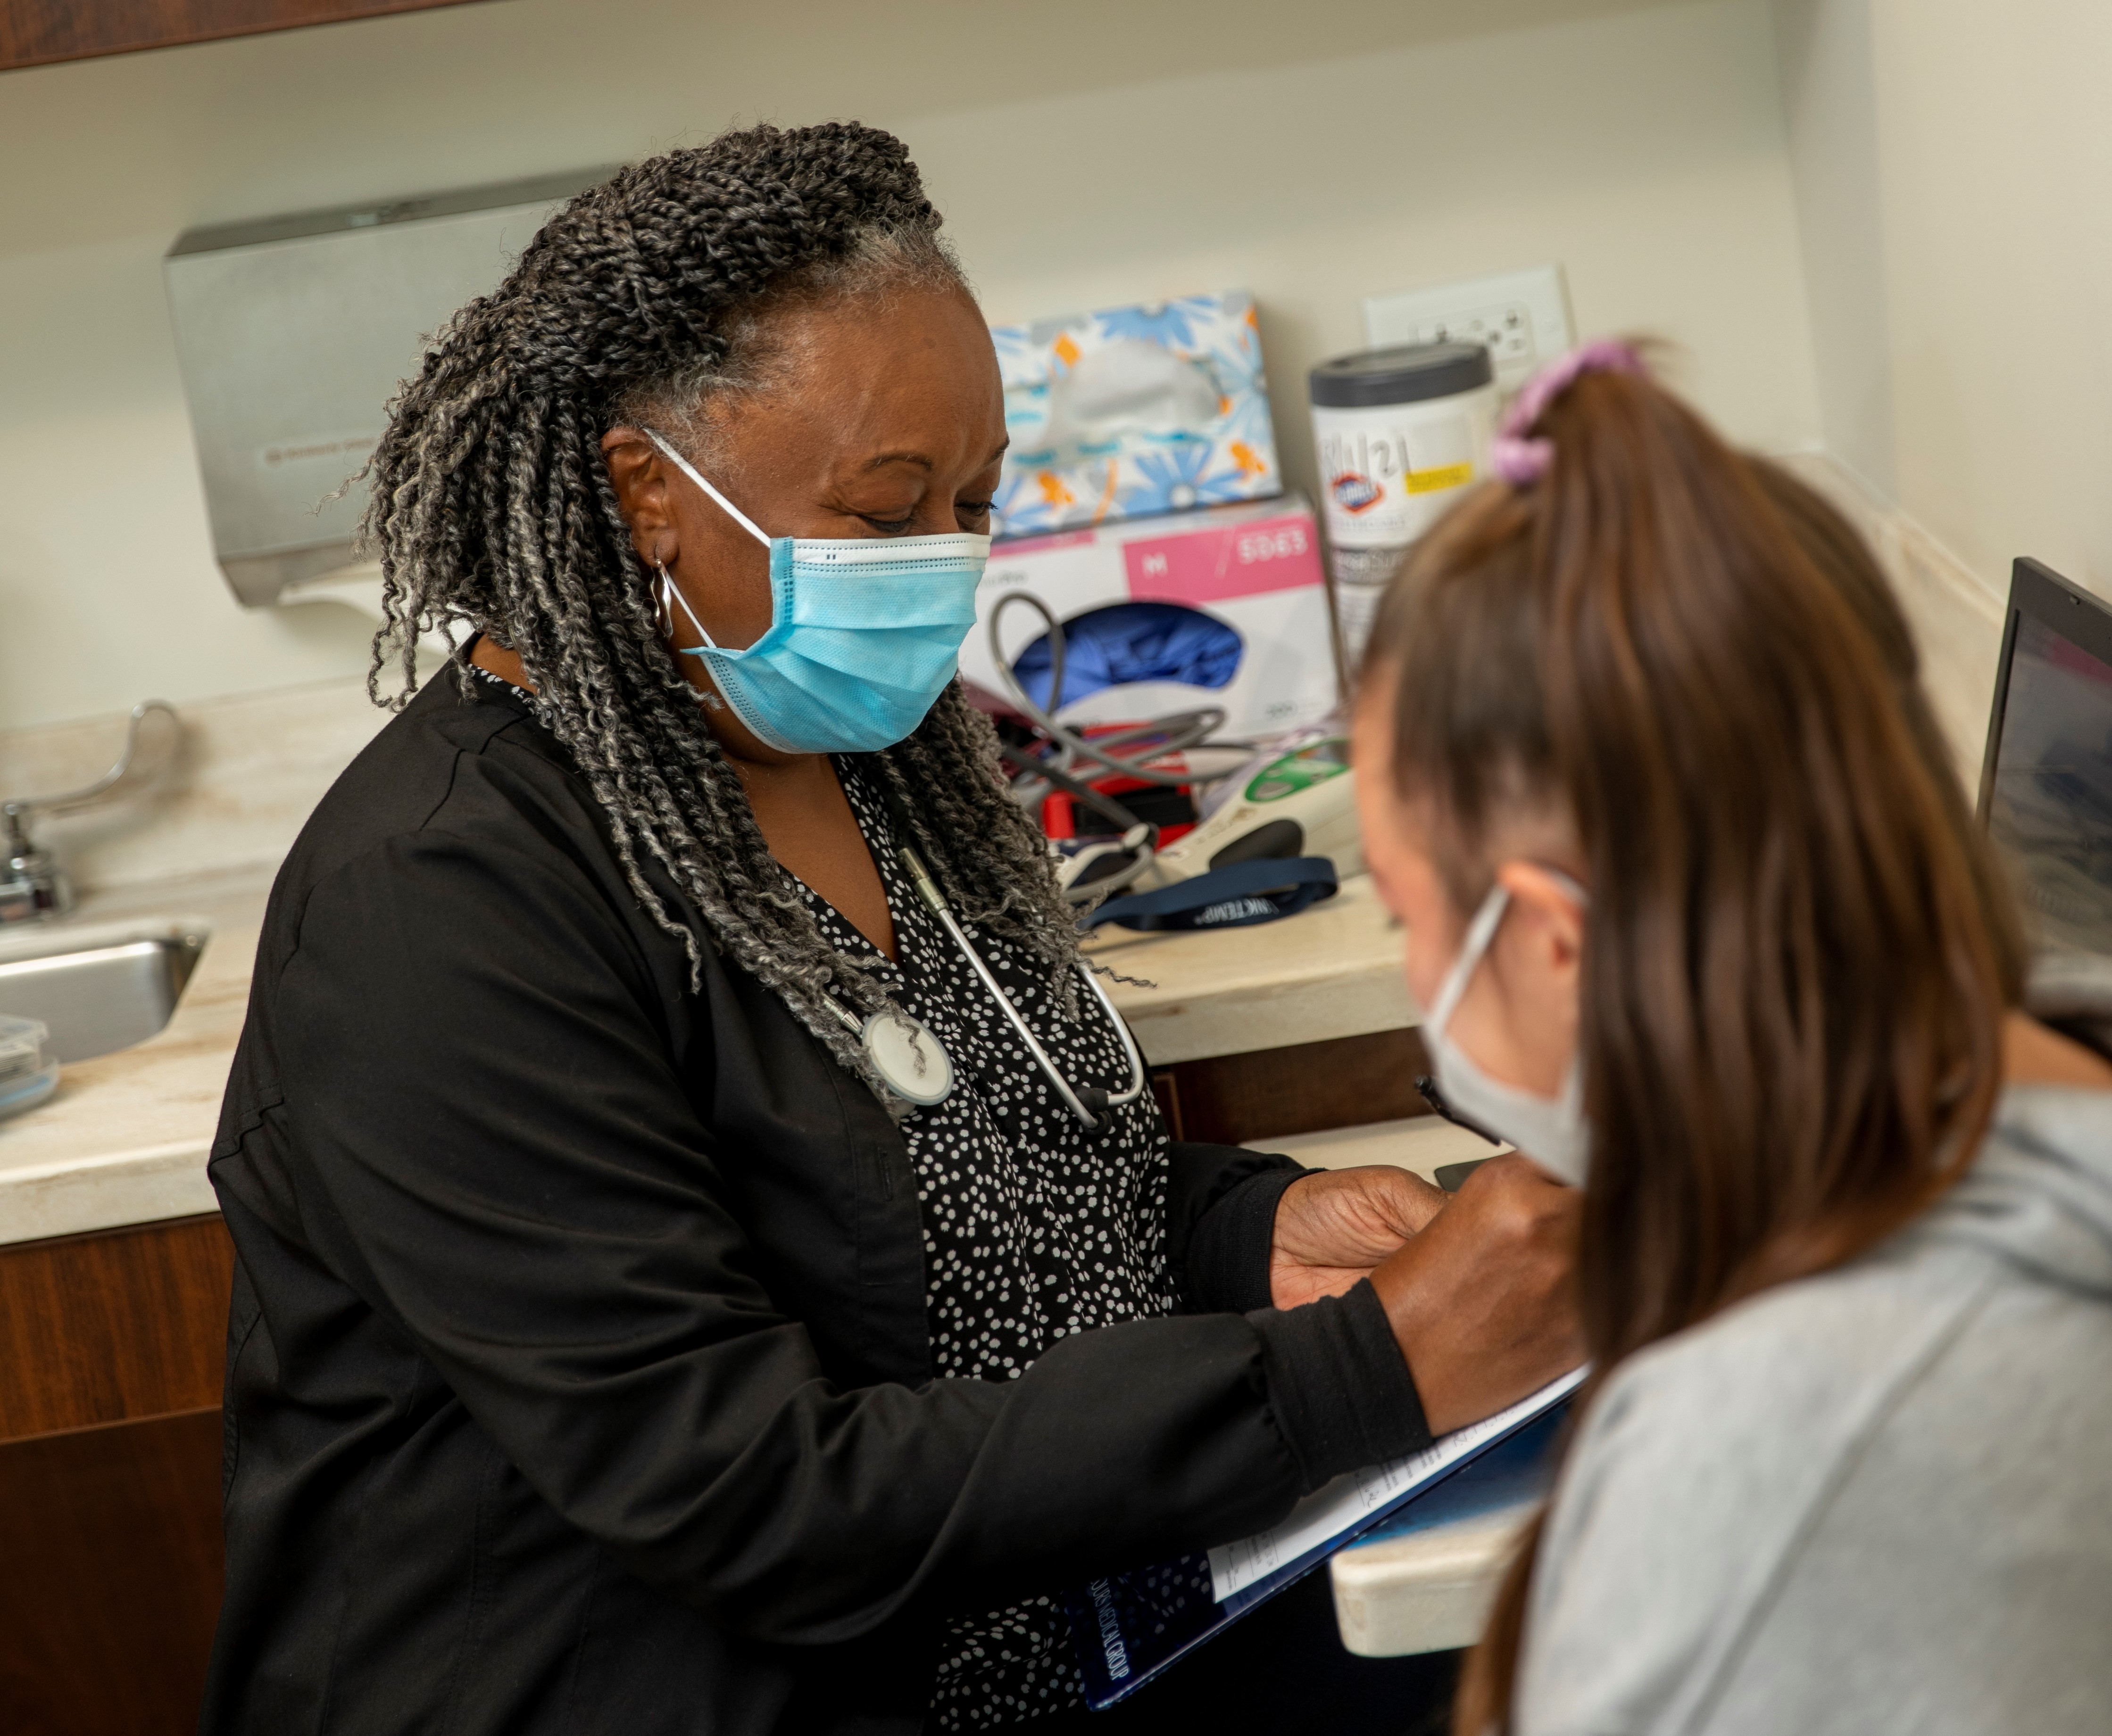


Mercy Health Foundation Clark & Champaign Counties​​
Notes:
These presentation notes have been designed to be read verbatim by the leader
Today we will be reviewing the upcoming Bon Secours Mercy Health Associate Campaign!

Slide 2
WHAT IS GIVE FOR GOOD?
OUR ANNUAL ASSOCIATE GIVING CAMPAIGN
The Campaign is an opportunity for Associates to support the mission of Bon Secours Mercy Health through a variety of gift options that benefit our patients, associates, and the local communities we serve.
Notes:
What is the Give for Good Associate Giving Campaign?
The Campaign is an opportunity for our associates to support our mission through a variety of gift options. Gifts can be directed to your community and to several programs and special projects.
This year’s campaign kicks off on August 28th with our day of giving celebration, THE BIG GIVE.
The Campaign will continue through the entire month of September. Associates will be receiving campaign information at their home, by email, and through the Weekly Pulse.

Slide 3
MEET REGINA
Giving to the Foundation is personal for Regina. It's a way to give back to the community that has supported her.
Notes:
Giving to Mercy Health Foundation is personal for associate Regina Queen. It's a way to give back to the community that has supported her.
“It’s important to help others who need a hand up,” she says. “I’ve had hard times myself, and now I want to pay it forward.”
Regina is a lab supervisor at Mercy Health - Urbana Hospital. She gives to the Springfield Greatest Need Fund to support her hometown. “It could impact someone I know,” she says. “They have a range of programs and they help those who need it most.”
As impactful as her giving is to others, it's also easy for her. Regina gives through payroll deduction as a Lead for Good donor. She is proud to provide steady support to her community.
“I definitely encourage other associates to give. It’s easy to give a little bit out of your check to help others.”

Slide 4

WHAT is THE BIG GIVE?
The 24-hour fundraising event to kick-off the Give for Good Campaign.
HOW can I celebrate THE BIG GIVE?
Watch for emails for more details.
WHY should I participate?
Every contribution adds up and can make a difference for those we serve. You can become eligible for rewards and counted in THE BIG GIVE efforts if you give NOW until 8/28/24
Current recurring gift donors will be counted and eligible for incentives.
Notes:
This year, THE BIG GIVE will take place on August 28th and will launch this year’s campaign.
This is a call to action for associates to make their gift in the first 24 hours of the Give for Good campaign and engage in activities in celebration of the kick-off of Give for Good.
There will be fun giveaway items and specific THE BIG GIVE incentives for associates who give at the Power Hour, Half Hour Hero, and Lead for Good levels.
Make sure to make your gift before midnight on 8/28!
Donors who have recurring gifts do not need to renew and will be eligible for THE BIG GIVE incentives.

Slide 5
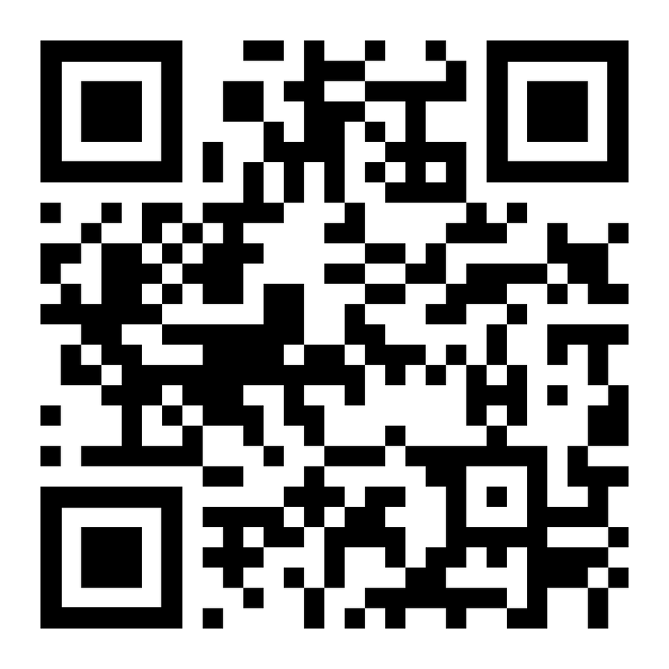
WAYS TO GIVE
Per Pay Period Deductions
  Power Hour
  Lead for Good
  Half Hour Hero
  Other chosen amount
One-time gifts: cash, credit card, payroll deduction
PTO
  Hourly associates
Visit bsmhgiveforgood.com or scan the QR Code to make your gift today!
Notes:
There are many different ways an associate can choose to make a gift.
Per pay period deductions that will take place the first pay period of 2025.
Associates can choose to do a per pay period deduction at the Power Hour level, which one hour of pay per pay period, Lead for Good, a $1,001 pledge for the year that can be deducted evenly throughout the year or in one deduction, Half Hour Hero, a gift of a half hour of pay per pay period, or at any amount they would like.
There is also an opportunity for associates to do a one-time payroll deduction that will take place in November. One-time gifts made by cash and credit card are also accepted.
Hourly associates are able to donate unused PTO (only hourly due to HR policy, if asked.)
Gifts can be made by simply filling out a form online at bsmhgiveforgood.com or returning the brochure received at each associate's home.

Slide 6

INCENTIVES
Power Hour = 1 hour of pay per pay period
Lead for Good = $1,001 one-time gift or $38.50 per pay period
1,200 Called to Shine points
1,000 Called to Shine points
Half Hour Hero = One half hour of pay per pay period
600 Called to Shine points
Notes:
If associates give at the Power Hour, Lead for Good, or Half Hour Hero level, they can be eligible for the following rewards:
POWER HOUR 1 hour of pay per pay period
1,200 Called to Shine points
LEAD FOR GOOD $1,001 gift either one time or spread over 26 pay periods
1,000 Called to Shine points
HALF HOUR HERO ½ hour of pay per pay period
600 Called to Shine points
As a bonus, if a gift at these levels is made before midnight August 28th during THE BIG GIVE, donors can be eligible for a free shirt.

Slide 7

INCENTIVES
Donors who make a first-time recurring gift before midnight 8/28/24 will receive 500 Called to Shine Points
All other recurring gifts will receive 100 Called to Shine Points
All donors will receive 75 Be Well points.
Notes:
In addition to the giving level incentives:
Donors who make a first-time recurring gift before midnight 8/28/24 will receive 500 Called to Shine Points
All other recurring gifts will receive 100 Called to Shine Points
ALL DONORS will receive 75 be well points

Slide 8
KEY CONTACT INFORMATION
Quincy Booker: BSMH Foundation Event Coordinator
    qbooker@mercy.com
(567) 259-9212
Clare Gordon: Senior Employee Giving Specialist
    csgordon@mercy.com
    (513) 638-6811
Elisheba Hawkins: Employee Giving Specialist
    ehawkins@mercy.com
    (513) 410-6272

Slide 9


Together we can make an impact right where we live & work!
BSMHgiveforgood.com
Notes:
Thousands of Bon Secours Mercy Health Associates support the Foundation's giving campaign each year. Many programs and services that help our patients and associates depend on your donations.
You will receive a letter and brochure with giving options for our market at home in August. Please read through the brochure and consider a gift to programs that mean the most to you.
The fastest and easiest way to give is online at BSMHgiveforgood.com.
Thank you!

